Slide 1
Fundamentals of Internet Programming
Chapter 1 – Basics of Internet Programming(Web Programming)

Slide 2
Contents
Network
Internet
World Wide Web
Client Server Architecture
Uniform Resource Locators(URL)
Domain Name Systems(DNS)
Document Types and MIME
What is Hyper Text Transfer Protocol(HTTP)
HTTP methods
HTTP Messages

Slide 3
Network
A network consists of two or more computers that are linked in order to share resources (such as printers , Scanners, etc.), exchange files, or allow electronic communications.
The computers on a network may be linked through cables, telephone lines, radio waves, satellites, or infrared light beams.
common types of networks include:
Local Area Network (LAN)
Metropolitan Area Networks (MAN),
Wide Area Network (WAN)
Notes:
You may also see references to a Metropolitan Area Networks (MAN), a Wireless LAN (WLAN), or a Wireless WAN (WWAN).

Slide 4
INTERNET
The Internet (or internet) is the global system of interconnected computer networks that uses the Internet protocol suite (TCP/IP) to communicate between networks and devices.
It is a network of networks that consists of private, public, academic, business, and government networks of local to global scope, linked by a broad array of electronic, wireless, and optical networking technologies.
The Internet carries a vast range of information resources and services, such as the interlinked hypertext documents and applications of the World Wide Web (WWW), electronic mail, telephony, and file sharing.
Notes:
Hypertext is text displayed on a computer display or other electronic devices with references (hyperlinks) to other text that the reader can immediately access.^{[1]} Hypertext documents are interconnected by hyperlinks, which are typically activated by a mouse click, keypress set, or screen touch. Apart from text, the term "hypertext" is also sometimes used to describe tables, images, and other presentational content formats with integrated hyperlinks. Hypertext is one of the key underlying concepts of the World Wide Web,^{[2]} where Web pages are often written in the Hypertext Markup Language (HTML). As implemented on the Web, hypertext enables the easy-to-use publication of information over the Internet.

Slide 5

World Wide Web (WWW)
World Wide Web, which is also known as a Web, is a collection of websites or web pages stored in web servers and connected to local computers through the internet.
These websites contain text pages, digital images, audios, videos, etc. Users can access the content of these sites from any part of the world over the internet using their devices such as computers, laptops, cell phones, etc.
The WWW, along with internet, enables the retrieval and display of text and media to your device.
The World Wide Web was invented by Tim Berners-Lee in 1989.
Notes:
A Local Area Network (LAN) is a network that is confined to a relatively small area. It is generally limited to a geographic area such as a writing lab, school, or building.
Wide Area Networks (WANs) connect networks in larger geographic areas, such as Florida, the United States, or the world. Dedicated transoceanic cabling or satellite uplinks may be used to connect this type of global network.

Slide 6
Client Server Architecture
A server is the one who provides requested services. is a remote computer that provides access to data and services.
Clients are the ones who request services. the client is a computer/device, also called a Host, that actually uses the service or accepts the information. Client devices include laptops, workstations, IoT devices, and similar network-friendly devices.
Client-server architecture is a computing model in which the server hosts, delivers, and manages most of the resources and services requested by the client.
Client Server Architecture Examples
Mail Servers : for sending and receiving email messages. e.g. gmail, Hotmail, yahoo mail
File Servers: used as a centralized location for files. E.g. Google Docs, Microsoft Office 360
Web Servers: used to host different websites.
Notes:
Email servers are used for sending and receiving emails. There are different software that allows email handling.
File servers act as a centralized location for files. One of the daily life examples to understand this is the files that we store in Google Docs. The cloud services for Microsoft Office and Google Docs can be accessed from your devices; the files that you save from your computer can be accessed from your phone. So, the centrally stored files can be accessed by multiple users.
Web servers are high-performance computers that host different websites. The server site data is requested by the client through high-speed internet.

Slide 7
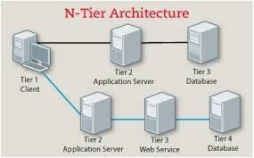
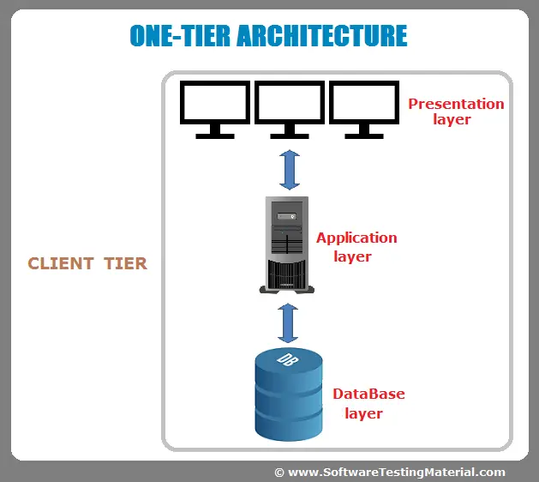
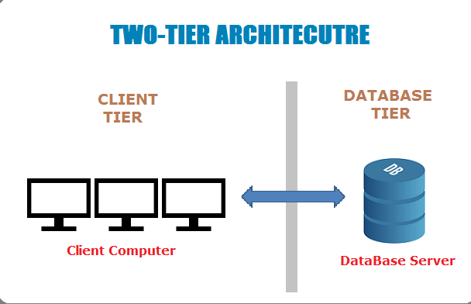
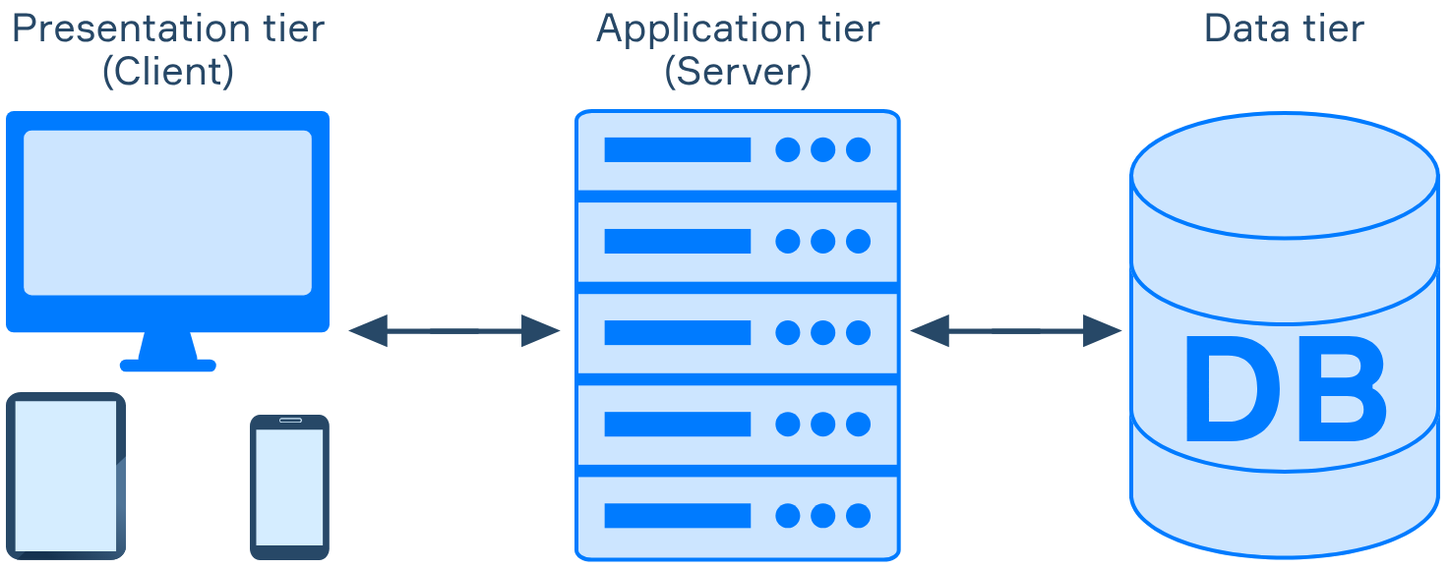
Client Server Architecture…. Con’d
Types of Client-Server Architecture
1-tier architecture
2-tier architecture
3-tier architecture
N-tier architecture
Notes:
One-Tier Architecture: One-Tier architecture is a basic program that runs on a single computer without network access. User requests do not control any network protocols; consequently, the code is simple and the network is alleviated of excess traffic.
Two-Tier Architecture: Two-Tier architecture consists of a client, a server, and a protocol connecting the two tiers. The code for the Graphical User Interface resides on the client host, while the logic for the domain resides on the server host.
One-Tier Architecture: One-Tier architecture is a basic program that runs on a single computer without network access. User requests do not control any network protocols; consequently, the code is simple and the network is alleviated of excess traffic.
Two-Tier Architecture: Two-Tier architecture consists of a client, a server, and a protocol connecting the two tiers. The code for the Graphical User Interface resides on the client host, while the logic for the domain resides on the server host.
Three-Tier Architecture: The presentation tier is the User Interface layer, the application tier is the service layer that conducts detailed processing, and the data tier is a database server that stores data.
N-Tier Architecture: N-Tier architecture divides an application into logical layers, which segregate responsibilities and manage dependencies, and physical tiers, which run on separate machines, enhance scalability, and increase network latency. N-Tier architecture may be closed-layer, wherein a layer can only communicate with the layer below it, or open-layer, wherein a layer can communicate with all layers below it.

Slide 8
Uniform Resource Locator(URL)
A Uniform Resource Locator (URL), also known as an address on the Web, is a reference to a resource that specifies its location on a computer network and a mechanism for retrieving it.
A URL is a specific type of Uniform Resource Identifier (URI).
URLs occur most commonly to reference web pages (HTTP/HTTPS) but are also used for file transfer (FTP), email (mailto), database access (JDBC), and many other applications.
Most web browsers display the URL of a web page above the page in an address bar. A typical URL could have the form
http://www.example.com/index.html
which indicates a protocol a hostname a file name
Notes:
A Uniform Resource Identifier (URI) is a unique sequence of characters that identifies a logical or physical resource used by web technologies. URIs may be used to identify anything, including real-world objects, such as people and places, concepts, or information resources such as web pages and books.

Slide 9
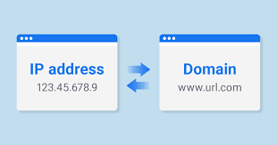
Domain Name System (DNS)
The Domain Name System (DNS) is the phonebook of the Internet. Humans access information online through domain names, like facebook.com or hu.edu.et. Web browsers interact through Internet Protocol (IP) addresses.
DNS translates domain names to IP addresses so browsers can load Internet resources.
Notes:
Each device connected to the Internet has a unique IP address which other machines use to find the device. DNS servers eliminate the need for humans to memorize IP addresses such as 192.168.1.1 (in IPv4), or more complex newer alphanumeric IP addresses such as 2400:cb00:2048:1::c629:d7a2 (in IPv6).

Slide 10
Web Documents
Web Documents are often defined as a simple HTML files. A web document, is often made up of several files and is accessed via a URL (uniform resource locator).
The HTML file itself contains most of the times style sheets, background images, other graphics, Java programs, and other files.
HTML files are often associated with Web Documents.
However, there are many other files types, which are often used for web sites in the world wide web. Some of the more popular examples are:
SGML (Standard Generalized Markup Language)
XML (Extensible Markup Language)
JSON (JavaScript Object Notation)
XUL (XML User Interface Language)
SVG(Scalable Vector Graphics)
Web developer use these different files types in order to create more dynamic web pages which have a more modern look compared to older static web pages.
Notes:
The Standard Generalized Markup Language (SGML; ISO 8879:1986) is a standard for defining generalized markup languages for documents.
Scalable Vector Graphics (SVG) is an XML-based vector image format for defining two-dimensional graphics, having support for interactivity and animation. The SVG specification is an open standard developed by the World Wide Web Consortium since 1999.
XUL (/ˈzuːl/ ZOOL), which stands for XML User Interface Language, is a user interface markup language developed by Mozilla.

Slide 11
Protocols
Protocol: is a set of rules the computer use to transfer file from one computer to another on an internet
The three major protocols
HTTP( Hypertext Transfer Protocol) : is just like the language that the browser and the web server use to talk.
MIME(Multipurpose Internet Mail Extension): is like the grammar instructor for the browser, say how to display a page.
FTP(File Transfer Protocol): is a tool for copying the pages to the server so called uploading.

Slide 12
HTTP
is an application-level protocol for distributed, collaborative, hypermedia information systems.
HTTP is a protocol for fetching resources such as HTML documents.
HTTP is a generic and stateless protocol .
By using its request methods, error codes, and headers we can get extra information's.
HTTP is a TCP/IP based communication protocol, that is used to deliver data (HTML files, image files, query results, etc.) on the World Wide Web.

Slide 13
The Fundamentals
HTTP
There are three basic features that make HTTP a simple but powerful protocol:
HTTP is connectionless: The HTTP client, i.e., a browser initiates an HTTP request and after a request is made, the client disconnects from the server and waits for a response.
HTTP is media independent:
HTTP is stateless: As mentioned above, HTTP is connectionless and it is a direct result of HTTP being a stateless protocol. The server and client are aware of each other only during a current request.
Notes:
HTTP is connectionless: The HTTP client, i.e., a browser initiates an HTTP request and after a request is made, the client disconnects from the server and waits for a response. The server processes the request and re-establishes the connection with the client to send a response back.
HTTP is media independent: It means, any type of data can be sent by HTTP as long as both the client and the server know how to handle the data content. It is required for the client as well as the server to specify the content type using appropriate MIME-type.
HTTP is stateless: As mentioned above, HTTP is connectionless and it is a direct result of HTTP being a stateless protocol. The server and client are aware of each other only during a current request. Afterwards, both of them forget about each other. Due to this nature of the protocol, neither the client nor the browser can retain information between different requests across the web pages.

Slide 14
HTTP Message
Is either a request from client to server or A response from server to client
Messages are composed of:
A start-line
Zero or more header fields
An empty line – indicating the end of the header fields
A message body (optional)

Slide 15
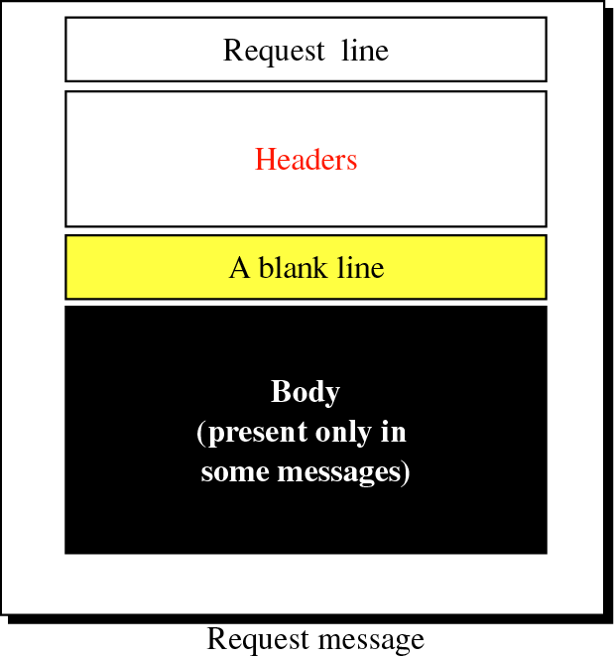
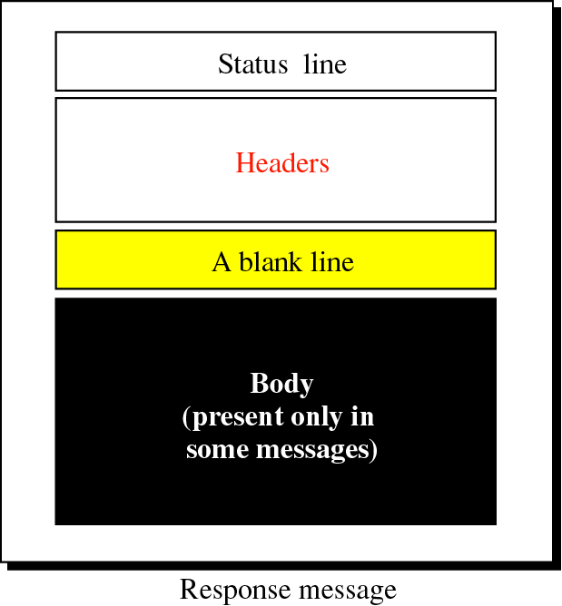
HTTP: Request and Response message
Notes:
Request line may contain protocols, protocol versions
Headers may contain, cookies, api keys,
Body the actual message you want to send contained in this part

Slide 16
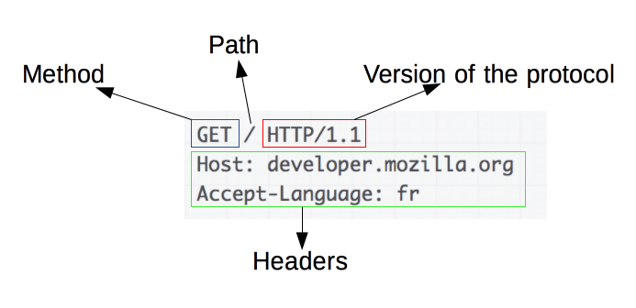

HTTP Request

Slide 17
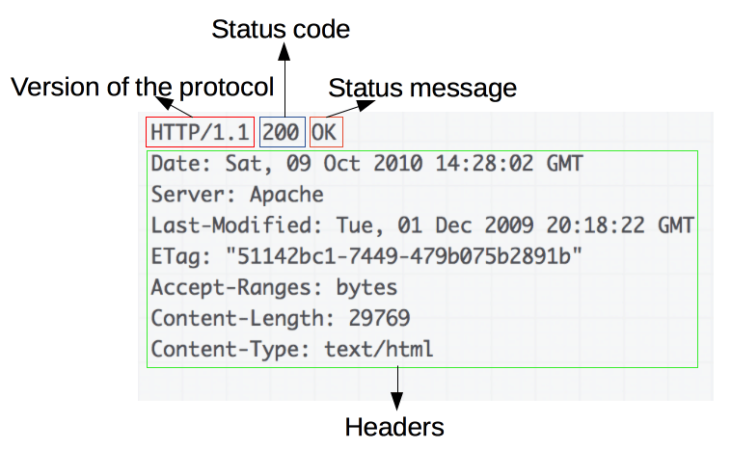
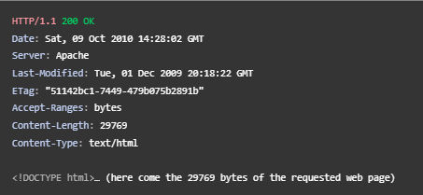
HTTP Response

Slide 18
Message Header Fields
Request Headers
Accept
Accept-Charset
Accept-Encoding
Accept-Language
Connection
Content-Length
Cookies
Response Headers
Content-Type
Content-Encoding
Content-Language
Connection
Content-Length
Set-Cookie

Slide 19
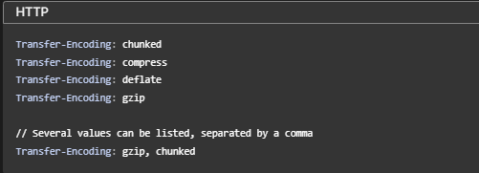
HTTP Header Types
General Header
Used to specify properties of the transfer process
Examples:
Connection: close – client wants to close the connection when the first response is complete
Cache-control – client can specify additional properties if the requested resource is cached (e.g. age)
Date
Transfer-Encoding
…
Notes:
the Connection general header controls whether the network connection stays open after the current transaction finishes. If the value sent is keep-alive, the connection is persistent and not closed, allowing for subsequent requests to the same server to be done.
The Transfer-Encoding header specifies the form of encoding used to safely transfer the payload body to the user.
chunkedData is sent in a series of chunks. The Content-Length header is omitted in this case and at the beginning of each chunk you need to add the length of the current chunk in hexadecimal format, followed by '\r\n' and then the chunk itself, followed by another '\r\n'. The terminating chunk is a regular chunk, with the exception that its length is zero. It is followed by the trailer, which consists of a (possibly empty) sequence of header fields.
compressA format using the Lempel-Ziv-Welch (LZW) algorithm. The value name was taken from the UNIX compress program, which implemented this algorithm. Like the compress program, which has disappeared from most UNIX distributions, this content-encoding is used by almost no browsers today, partly because of a patent issue (which expired in 2003).
deflateUsing the zlib structure (defined in RFC 1950), with the deflate compression algorithm (defined in RFC 1951).
gzipA format using the Lempel-Ziv coding (LZ77), with a 32-bit CRC. This is originally the format of the UNIX gzip program. The HTTP/1.1 standard also recommends that the servers supporting this content-encoding should recognize x-gzip as an alias, for compatibility purposes.
The Cache-Control HTTP header field holds directives (instructions) — in both requests and responses — that control caching in browsers and shared caches (e.g. Proxies, CDNs).
The HTTP cache stores a response associated with a request and reuses the stored response for subsequent requests.

Slide 20
HTTP Header Types
Entity Headers
Give meta-information about the entity body (message body) being transferred
Apply only if a message body exists
Examples:
Content-Encoding – indicates type of content encodings applied (e.g. zipped)
Content-Language – language of the intended audience
Content-Length – size of the entity body (message body)
Expires
…

Slide 21
HTTP Header Types
Request Headers
Add additional information about the request
May include information about the client/sender, including client capability
Examples:
Accept - acceptable media types for response
Accept-Charset – acceptable character set
User-Agent – client browser
…

Slide 22
HTTP Header Types
Response Headers
More information, in addition to the status line
May contain information about the server or resource
Examples:
Age – estimate of time since response was generated
Location – used to redirect to a different location (URI)
Proxy-Authenticate – proxy authentication challenge
Server – information about the web server software
…
Notes:
The HTTP Proxy-Authenticate response header defines the authentication method that should be used to gain access to a resource behind a proxy server. It authenticates the request to the proxy server, allowing it to transmit the request further.
Proxy-Authenticate is an HTTP header used by servers to request authentication from a client when accessing a proxy server. It is commonly used to protect sensitive information and ensure secure communication between the client and the proxy server.

Slide 23
HTTP Request
The request line contains three parts:
Request method
Request URI
HTTP Version
Request method
GET - (or retrieve) information from the server
POST - (information) back to the server
HEAD – like GET but only returns meta-information
PUT - (information) at the server, used for updating
DELETE - (information) from the server

Slide 24
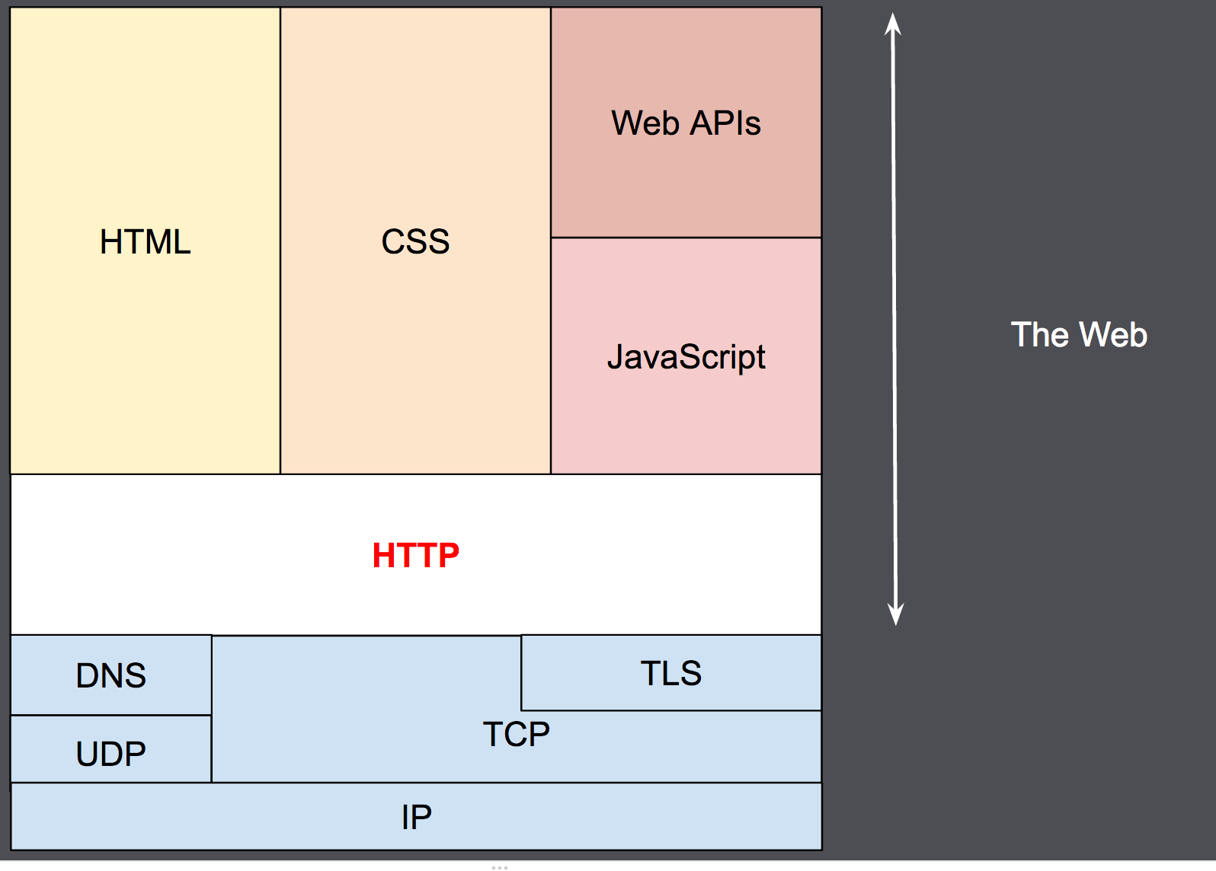
What We learn Next?

Slide 25
Thank You ☺

